Slide 1
SQL Capstone Project

Slide 2

Aim of the Project The major aim of this of project to gain the insight into the sales data of amazon to understand the different factors that affect sales of the different branches.

Slide 3

Analysis List
Product Analysis -
Conduct analysis on the data to understand the different product lines, the products lines performing best and the product lines that need to be improved.
Sales Analysis -
This analysis aims to answer the question of the sales trends of product. The result of this can help us measure the effectiveness of each sales strategy the business applies and what modifications are needed to gain more sales.
Customer Analysis-
This analysis aims to uncover the different customer segments, purchase trends and the profitability of each customer segment.

Slide 4

Approach
Data Wrangling
Feature Engineering
Exploratory Data Analysis (EDA)

Slide 5

Data Wrangling
We have download the data set of Amazon(excel / csv).
Import the dataset to MySQL Workbench.
Check The Datatypes.
Manipulate the data.
Like Alter/Update .

Slide 6
Feature Engineering
Add a new column named timeofday to give insight of sales in the Morning, Afternoon and Evening. This will help answer the question on which part of the day most sales are made.
Add a new column named dayname that contains the extracted days of the week on which the given transaction took place (Mon, Tue, Wed, Thur, Fri). This will help answer the question on which week of the day each branch is busiest.
Add a new column named monthname that contains the extracted months of the year on which the given transaction took place (Jan, Feb, Mar). Help determine which month of the year has the most sales and profit.

Slide 7
Question On Dataset ?

Slide 8



1.What is the count of distinct cities in the dataset?
2.For each branch, what is the corresponding city?
3.What is the count of distinct product lines in the dataset?

Slide 9



4.Which payment method occurs most frequently?
5.Which product line has the highest sales?
6.How much revenue is generated each month?

Slide 10



7.In which month did the cost of goods sold reach its peak?
8.Which product line generated the highest revenue?
9.In which city was the highest revenue recorded?

Slide 11

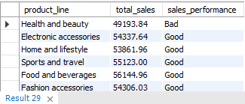

10.Which product line incurred the highest Value Added Tax?
11.For each product line, add a column indicating "Good" if its sales are above average, otherwise "Bad.“
12.Identify the branch that exceeded the average number of products sold.

Slide 12
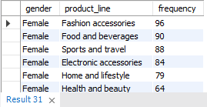
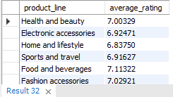
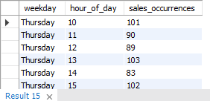
13.Which product line is most frequently associated with each gender?
14.Calculate the average rating for each product line.
15.Count the sales occurrences for each time of day on every weekday.

Slide 13



16.Identify the customer type contributing the highest revenue.
17.Determine the city with the highest VAT percentage.
18.Identify the customer type with the highest VAT payments.

Slide 14



19.What is the count of distinct customer types in the dataset?
20.What is the count of distinct payment methods in the dataset?
21.Which customer type occurs most frequently?

Slide 15


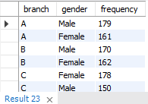
22.Identify the customer type with the highest purchase frequency.
23.Determine the predominant gender among customers.
24.Examine the distribution of genders within each branch.

Slide 16

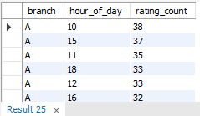

25.Identify the time of day when customers provide the most ratings.
26.Determine the time of day with the highest customer ratings for each branch.
27.Identify the day of the week with the highest average ratings.

Slide 17
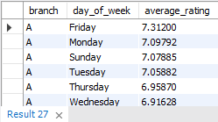
28.Determine the day of the week with the highest average ratings for each branch.

Slide 18
THANK YOU

